Slide 1
Project Review Meeting 2
Mubeena Nazar
S4 MCA
Roll no : 41

Slide 2
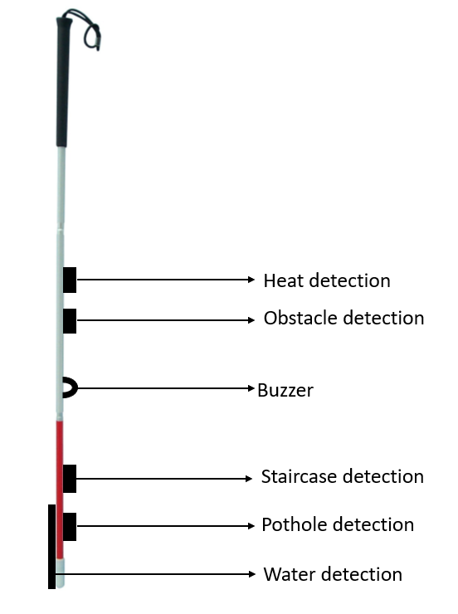
BLUEPRINT OF SMART BLIND STICK

Slide 3
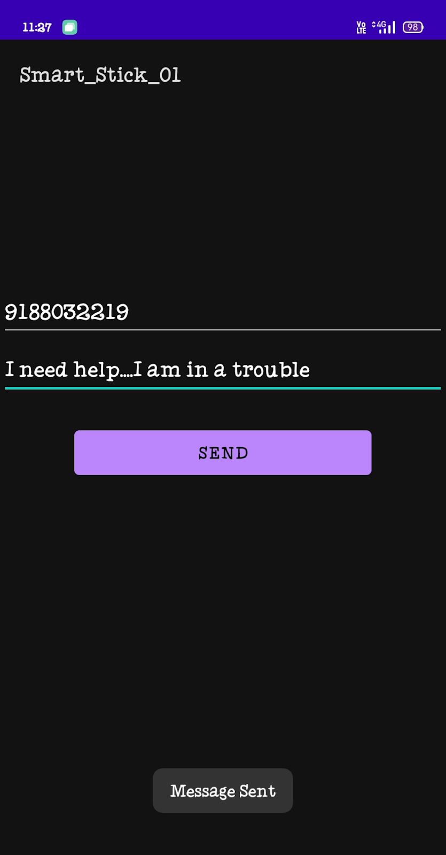
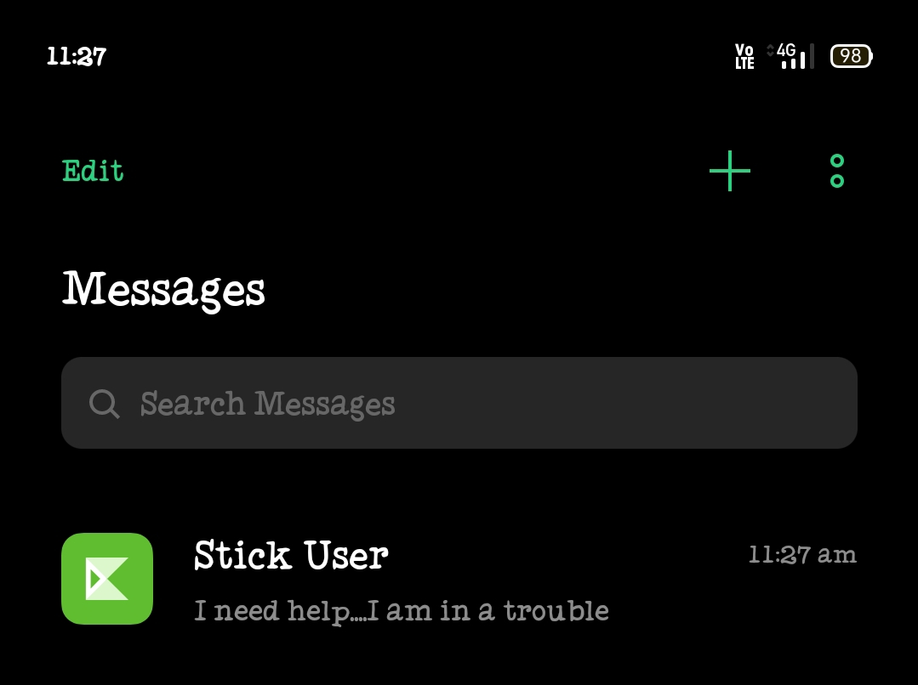

Developed an app for sending SMS to concerned person in case of Emergencies

Slide 4
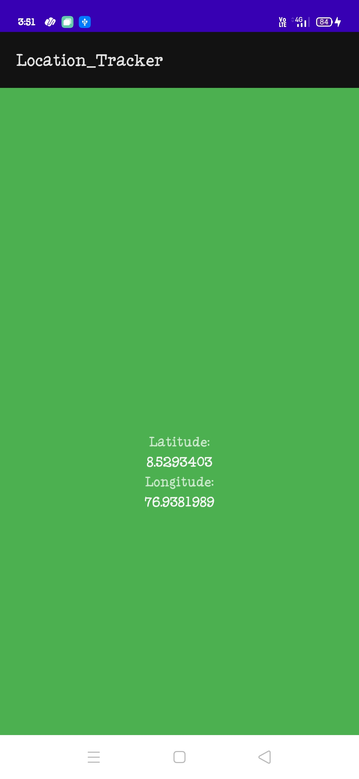
Developed the functionality for sending location to concerned person in case of Emergencies

Slide 5
TIME LINE
Topic Finalized
23-4-22
Abstract
25-04-22
Approval meeting
Literature Survey
Scrum meeting 1
28-04-22
30-04-22
15-05-22
Preparing with base papers
Ordered Equipment
10-05-22
19-05-22
Scrum meeting 2
21-05-22
Review Meeting
24-05-22
Scrum Meeting 3
28-05-22
Completed detection of each module
27-05-22
Scrum Meeting 3
28-05-22
Developing the android app

Slide 6
NEXT STEP
Integrating all the components together
Developing location tracking functionality

Slide 7
Thank You

